Slide 1
Python Workshop 1 Demonstration
2026 – Wendy Olsen v1.0
This material is creative commons so if you want to cite it, go ahead. Don’t copy it without citing it. You can amend it but still, cite your original source. Thank you so much (in advance).
Online location of key documents

Slide 3
Basic python programming
Input | Method() | Function | A type of entity | Put it together
Read… | Sort_values() |  | Tuple; list; | See program.
 |  | Can be user-defined | Dataframe; | The sample code is about
 |  | Can have default parameters | Array | Population.
print | Display | [entity name] | File type csv output | Image .png output
Print(mydata) | Display(mydata) | mydata | Write_csv(mydata.,,,) | First, make a graph
Help is at hand! See Zed Shaw’s book
(online $ 29 )
URL Learn Python the Hard Way
Buy this at a used bookshop URL https://www.abebooks.co.uk/

Slide 4
Four kinds of loops and where to get help with writing computer code
If loops | For loops | While loops | Iterative use of object | Iterative Function, ie a function embedded in a for loop for example
If condition: indent… is python code format. | For condition or term: Indent … is python code format. | While … action | A. what is an iterable object? Something like a sentence or a word | Def myamends(): activity 1 activity 2 return amendeddf
 | You need to avoid the risk of unending looping | You need to avoid the risk of unending looping | B. What is itertools? In python, it can easily discover each digit in a number, each letter in a word, or each word in a sentence. | Notice above that the indentation is crucial to the defined function. Suppose Activity 2 is a “for” loop. It has an output product, the amended dataframe.
 |  |  | C. There is also iterrows
Help is at hand! See Zed Shaw’s book
(online $ 29 ) Chapters 29 to 35.
URL Learn Python the Hard Way
Or buy it at used bookshop URL https://www.abebooks.co.uk/

Slide 5
Sample Program Chunk in Python
myagesexdat = pd.read_csv("D:\\pyprogramsAndSims/data/SyntheticAgeSexImmigDataLarge.csv")
mynoneu = myagesexdat[myagesexdat["type"] == "Noneu"]
mynoneu.head()
myagesexdat = myagesexdat[myagesexdat["type"] == "Noneu"]
myagesexdat.head()
Print out 20 rows of data to the console. |  | Head() Tail() | What are head() and tail()?
Mydata.head(20) |  | Mydata.head() | These are ‘methods’. Here the default is 5 rows.
 |  | Notice the format is Entity.method() | They were written into Python language.
20 is the parameter |  | The parameter is used by the method.

Slide 6
Sample Program Chunk in Python
Notice the input step | = is an assignment operator
[ ] is bracket notation, ideally square bracket notation, indicating rows by default | Dataframe[rownames] is an example of Entity[listnumbers]
To choose by row and column, use the .loc() or .iloc() method | Can you see the assignment operator again?
myagesexdat["type"] == "Noneu"] is a condition, which rows must conform to. | Entity[rowname] Is similar to Entity[rowcondition]
Six easy conditionals | ==, ~=, >=, <=, <, >
These are operators. | = is the assignment operator. == checks for equality so it’s a conditional operator.
myagesexdat = pd.read_csv("D:\\pyprogramsAndSims/data/SyntheticAgeSexImmigDataLarge.csv")
mynoneu = myagesexdat[myagesexdat["type"] == "Noneu"]
mynoneu.head()
myagesexdat = myagesexdat[myagesexdat["type"] == "Noneu"]
myagesexdat.head()

Slide 7
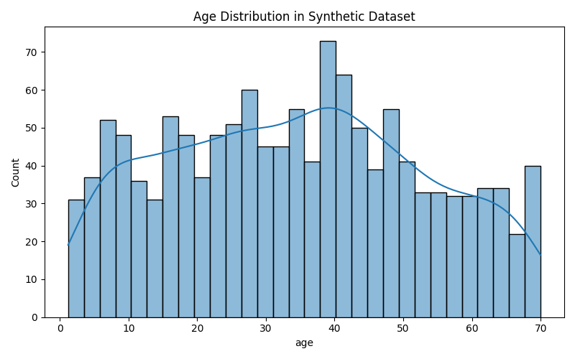
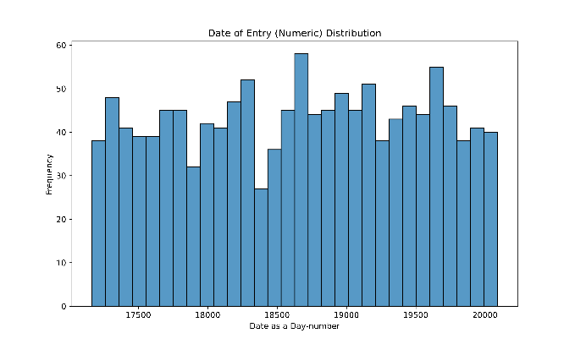
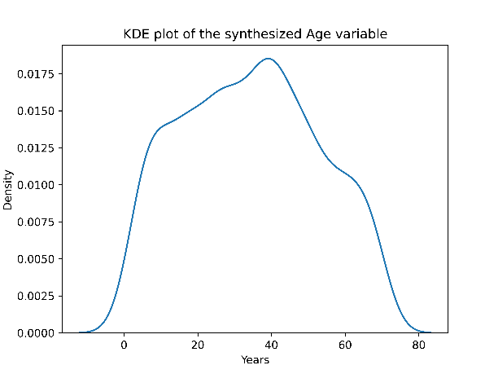
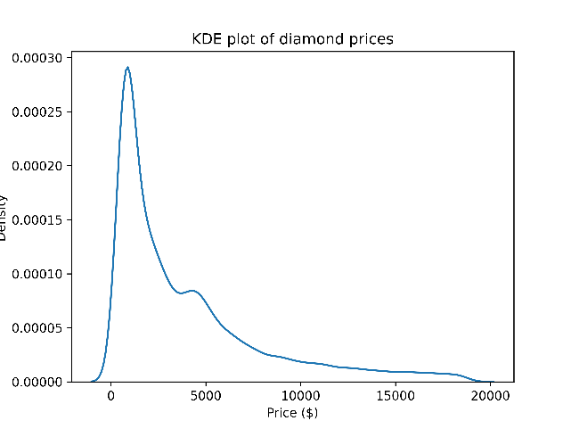
Taster Figures
Data-science style
Histograms
Kernel density diagrams
Raise your ambitions

Slide 8
Resource documents
Basic Python – installation and coding
PSD_Capability_Building – uses basic Python.
Basic resources: Session Resources - Folder containing materials for some coding upskilling sessions (Defines what “DAP” “CATS” Wiki is; shows how one runs Python in DAP by demonstration, step by step)
Introduction to Python course; one of these is at URL https://learninghub.ons.gov.uk/course/view.php?id=1168
also webpage file:///C:/Users/OlseNW/Downloads/ITP_course_intro%20(1).html.

Slide 9
Frequently asked questions

Slide 10
Questions & Answers

Slide 11
Learning Task 1
Learning task 1: You are a Winner if you can calculate an answer to this problem using Python:😊 Suppose the world population is 8 billion. Suppose the net pop growth rate is +0.85% per year. Calculate what year the world population would reach 14 billion. Later on, using a loop, substitute more accurate starter populations such as 8.2 billion, 8.45b.

Slide 12
Your activities
Learning task 1- Extra challenge - You could gather the sum from this kaggle file of country populations, https://www.kaggle.com/datasets/asadullahcreative/world-population-by-country-2025 , accessed Dec. 2025. Print a list of the starting population and year of reaching the target.

Slide 13
Tasks 3 and 4
Learning task 2: can you write a bit of code, which sets the path for output files out of Python in your Python interpreter? You will have a chance to ask questions about key terms like interpreter, path, and output files so it is a workshop open to all, including beginners. You may want to try xlsxwriter package (you must use pip to install this, then import it) and write a csv or xlsx file. I myself use VS Code instead of Spyder but it’s up to you. Spyder, Jupiter and VS Code are known as ‘interfaces’ or ‘VDI’s for Python. Choose one.
Learning task to jump into this as a Newbie: RunMS Copilot by using https://m365.cloud.microsoft/chat/?home=1&auth=2 [You will need to log in to MS 365 beforehand. Do not worry, it is fine to login to MS 365 but do it in your laptop. Don’t do this in your secure area (DAP).] Ask copilot to write you some code to set the path for output files using your Python interpreter version 3.11 or which version you use. A beginner book: McKinney, Wes (2012), Python for Data Analysis. 3rd edition available https://wesmckinney.com/book , 3rd ed. Pub. 2022.(Open Access)

Slide 14
Answers
See two types of document. The html or word document containing a full rundown of Introductory Exercises. Or the Python code files:
  The file .ipynb is a Jupyter format document including some results. It’s like an R markdown file.
  The file .py is a Python base code document. You can run single lines, chunks or all of it, by SELECT ALL, Run, in your interpreter.
  After you get experienced, you get stuck. This is normal.
  Climb the mountain of solving problems by trial-and-error.
  Make notes of your Debug solutions.
  Study the notes, study your ‘operating system’ and become more expert.

Slide 15
Legitimate sources on the internet
A pandas tutorial for beginners
  https://sparkbyexamples.com/python-pandas-tutorial-for-beginners/
A high-schools website for python users, really accurate too:
  https://www.w3schools.com/python/python_for_loops.asp
How you make Spreadsheet outputs as tables,
  See https://xlsxwriter.readthedocs.io/tutorial01.html, note tutorial 1:
Facilitator email wendy.olsen@ons.gov.uk
Facilitator personal github https://github.com/WendyOlsen

Slide 16
References / Where to go for help
Chambers and Zaharia, Spark: The Definitive Guide, https://www.oreilly.com/library/view/spark-the-definitive/9781491912201/ helps you study chunks of the book. (Use the Read Now button)
McKinney, Wes (2012), Python for Data Analysis: Data Wrangling with Pandas, Numpy, and Ipython. Singapore: O’Reilly. (3rd edition available https://wesmckinney.com/book , 3rd ed. Pub. 2022.(Open Access))
Shaw, Zed (2018) Learn Python the Hard Way, various editions, PDF is not free, available at https://www.informit.com/store/learn-python-the-hard-way-9780138270575 , see also https://learnpythonthehardway.org/ ) 5th ed., ISBN 0-13-827057-0, London: Addison-Wesley. Don’t forget to scroll down….
Practice skills: https://www.datacamp.com/courses/intro-to-python-for-data-science.

